Slide 1
Software engineering (Undergraduate)
Chapter 4 Software quality assurance
Course Name software quality and testing
CSC 4133
(Undergraduate)

Slide 2
Quality Assurance
Chapter 4: Software Quality Assurance
MMH
S.2
QA focus on correctness aspect of quality, and dealing with defects
QA activities can be classified into three generic categories –
Defect Prevention: QA activities prevent certain types of faults from being injected into the software since errors are the missing/incorrect human actions that lead to injection of faults into software systems (default values, options to select)
Defect Reduction: QA activities detect and remove certain faults once they have been injected into the software systems.
Defect Containment: control defect through fault tolerance, failure prevention, or failure impact minimization to assure software reliability and safety (e.g. auto save option)

Slide 3
Defect prevention
Chapter 4: Software Quality Assurance
MMH
S.3
Defect prevention can be done by two generic ways:
Error source removal (known error sources)
Eliminating certain error sources such as eliminating ambiguities or correcting human misconceptions, which are the root causes for errors and remove through education and training (people-based solution)
Error Blocking
Fault prevention or blocking by directly correcting or blocking these missing or incorrect human actions (e.g. user can not give 0 value to the divisor attribute; data validation in excel)
This will result the direct intervention to block errors (fault injections prevented)
Systematic defect prevention via process improvements
If imprecise designs and implementations, tools and technology that deviate from product specifications or design intensions are the causes for faults, formal methods can help prevent such deviations

Slide 4
Defect reduction
Chapter 4: Software Quality Assurance
MMH
S.4
It is unrealistic to expect the defect prevention activities to be 100% effective in preventing accidental fault injections. Following are the techniques to remove as many faults as possible
Inspection Method to Reduce Defects
The most commonly used static technique uses critical reading and analysis of software code, designs, product specifications, test plans, etc.
Formality and structures of Inspections varies in
Informal reviews/walkthroughs (self-conducted, independent, pass around, canteen discussion)
Formal Inspection are typically conducted by multiple human inspectors through some predefined coordination of process.

Slide 5
Defect reduction
Chapter 4: Software Quality Assurance
MMH
S.5
Testing Method to Reduce Defects
Involves the execution of software and the observation of the program behavior/outcome
If a failure is observed, the execution record is then analyzed to locate & fix the fault(s) that caused the failure.
Other techniques and Risk identification Method to Reduce Defects
Formal model-based analyses
Boundary value analysis (e.g. loop condition check)
Control flow and data flow analyses (e.g. conditional statements)
Simulation and Prototyping (e.g. Autopilot)

Slide 6
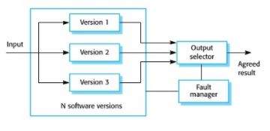
Defect containment
Chapter 4: Software Quality Assurance
MMH
S.6
Defect reduction activities can only reduce the number of faults to a fairly low level, but not completely eliminate them (because of the large size and high complexity of most software systems in use today as complete testing is not possible)
The containment measures focus on the failures by either containing them to local areas so that there are no global failures observable to users, or limiting the damage caused by software system failures (e.g. exception handling)
Defect Containment can be done in two generic ways:
Software fault-tolerance
Recovery: rollback and redo
NVP: N-Version programming (fault blocked)
Safety assurance and failure containment
MMH

Slide 7
Defect containment
Chapter 4: Software Quality Assurance
MMH
S.7
Safety assurance & failure containment
Safety : Accident free (e.g. Autopilot safety eliminate pilot error)
Accident: Failure with severe consequences
Hazard: Pre-condition to accident
Safety Assurance: Hazard analysis, hazard elimination/reduction/control, damage control

Slide 8
QA in software process
Chapter 4: Software Quality Assurance
MMH
S.8
Process variations
Waterfall development process
Iterative development process (QA in increments)
Spiral development process (QA & risk management)
Agile development process (XP- test driven development pair programming)
Maintenance processes (focus on defect handling)
Development components
Requirement
Specification
Design
Coding
Testing
Release
Mega-process
Initiation
Development
Maintenance
Termination

Slide 9
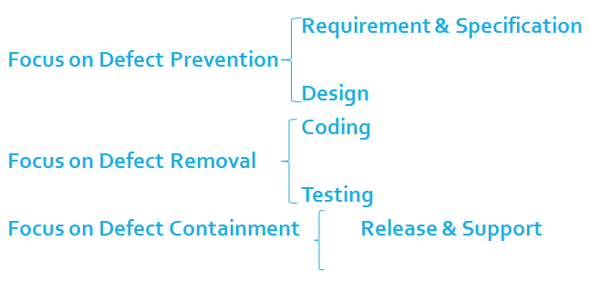
QA in waterfall software process
Chapter 4: Software Quality Assurance
MMH
S.9

Slide 10
QA Activities: Mapping from DC view to V&V view
Chapter 4: Software Quality Assurance
S.10
MMH
DC (defect-centered) view | QA activity | Validation(external focus) &Verification (internal focus) view
Defect prevention |  | Both, mostly indirectly
 | Requirement-related | Validation, indirectly
 | Other defect prevention (Project Plan) | Verification indirectly
 | Formal specification | Validation, indirectly
Defect Reduction | Testing type | Both, but mostly verification
 | Unit | Verification
 | integration | Both, more verification
 | system | Both
 | acceptance | Both, more validation
 | beta | Validation
Defect Containment |  | Both, but mostly validation
 | Operation | Validation
 | Design & implementation | Both, but mostly verification

Slide 11
references
Chapter 4: Software Quality Assurance
S.11
MMH
Software Testing And Quality Assurance – Theory and Practice - Kshirasagar Naik & Priyadarshi Tripathy
Software Quality Engineering: Testing, Quality Assurance and Quantifiable Improvement - Jeff Tian

